Slide 1
Pain Project
Saurabh Annadate, Finn Qiao,Tanya Tandon,
Qianqing Tang, Yufei Zhang

Slide 2
Agenda
Objective
EDA and Normalisation
Clustering and Time trend
Morphine equivalence vs. Patients' predicted pain level
Morphine equivalence vs. Patient's actual pain level
Regression Analysis
Conclusion and ROI

Slide 3
Objective
Time trends in pain level
Find group of patients with similar pain
Relationship between pain score and morphine equivalents
Establish ROI

Slide 4
Exploratory Data Analysis

Slide 5
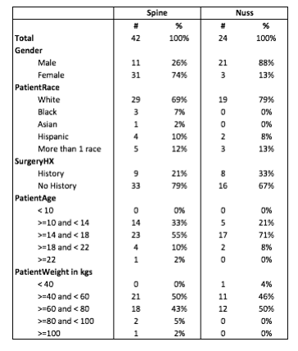
Key characteristics for the 66 patients that have been considered for our analyses
More female patients are getting Spine surgery( 74% of total ).
More male patients are getting Nuss surgery( 88% of total ).
White people are getting maximum surgeries ( ~ 80% )
Most people(~75%)don't have a surgery history.
More than 90% have weight in range 40 kgs- 80 Kgs.

Slide 6
Pain score were normalised to remove biases in the data due to subjective nature of pain
Two approaches were taken:
Pain Score Normalisation
Normalization with mean
For each patient, the pain scores were normalized by subtracting each 12 hr pain score by the mean of all 12 hr pain scores available
Normalization with mean VAS scores
VAS (Visual Analog Scale) scores provided by this tool were used as a measure of the actual pain. We have been provided the VAS scores for Post-Operative days 1 through 8 and subsequent 5 clinic visit

Slide 7
Clustering and Time Trend

Slide 8
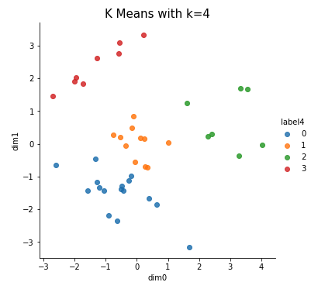
Spine Surgery patients are clustered to understand the relationship between their features
Spine Surgery
K = 4 is the optimum number of clusters
Age is a distinct demographic feature in these clusters with grouping in order of youngest, young, middle, old
It is difficult to classify these clusters on non-demographic features

Slide 9
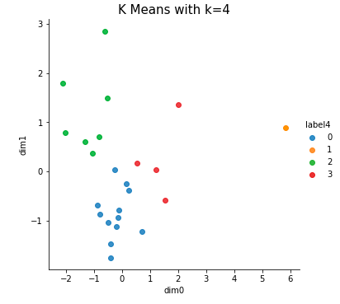
Chest Surgery patients are clustered to understand the relationship between their features
Chest Surgery
K = 4 is the optimum number of clusters.
2nd cluster is an outlier and is hence, ignored.
Age and weight are the two distinct demographic feature in these clusters.

Slide 10
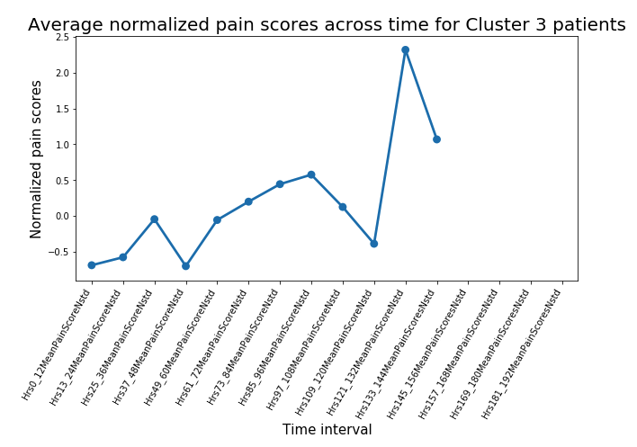
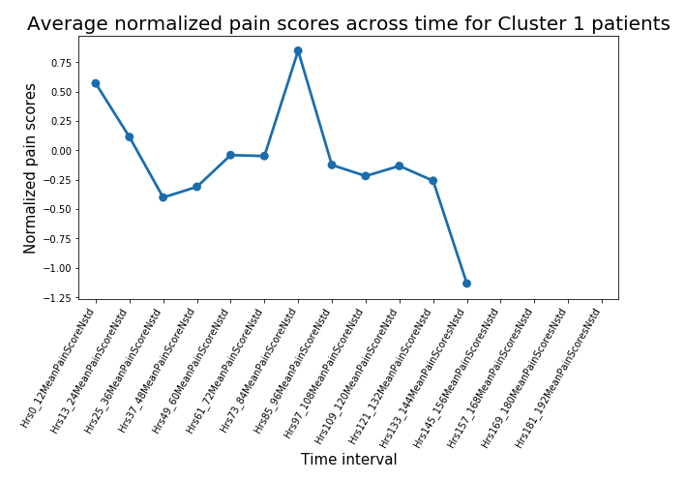
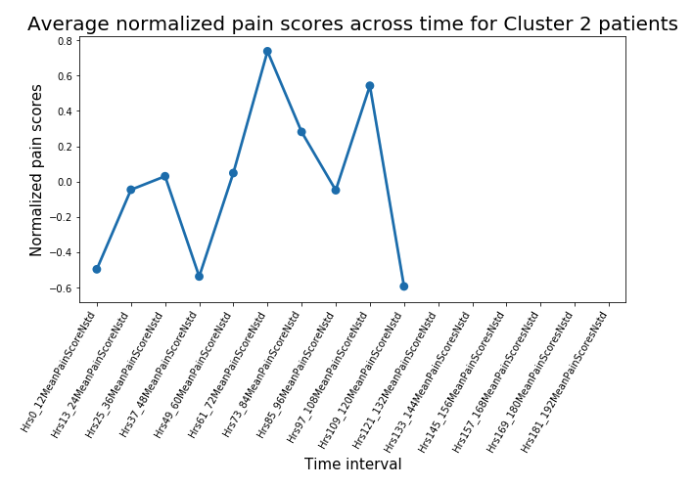
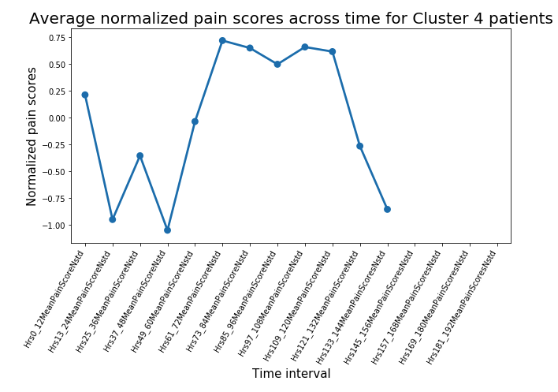
Time Trend of Pain for Clusters in Spine Surgery
Spine Surgery
Average pain for the cluster with oldest children (Cluster 3) has almost 3 times max pain than other categories( 2.5 vs 0.75)
This deformity usually occurs in age 10-15 years and gets worse with age
So, it makes perfect sense for older patients to have distinctly higher scores than their younger counterparts.

Slide 11
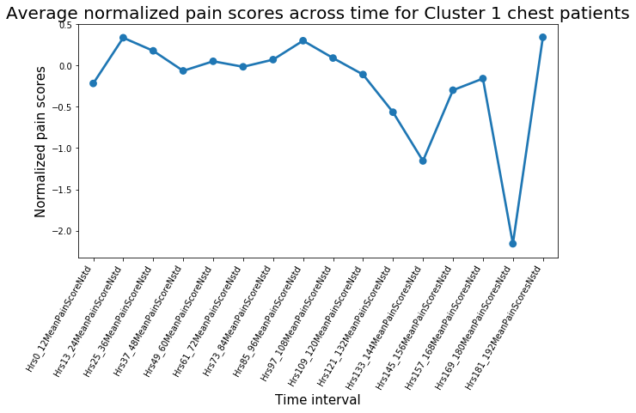
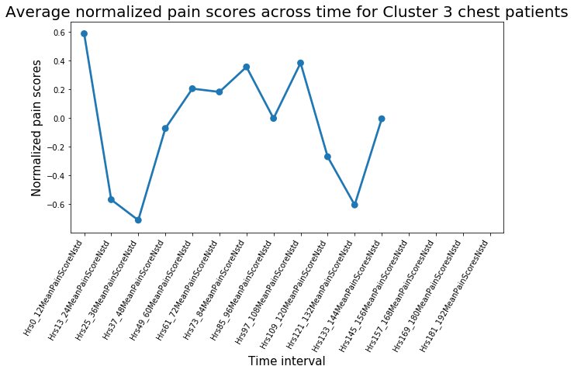
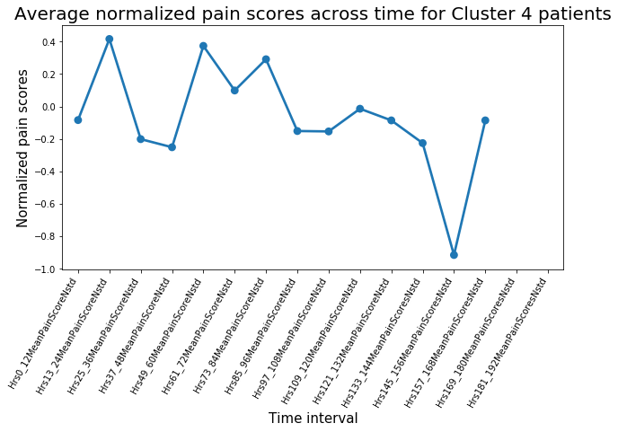
Time Trend of Pain for Clusters in Chest Surgery
Chest Surgery
The trends of pain level of the heaviest group and the lightest group during the first 24 hours are exactly the opposite.
The average pain level for cluster 1 patients is the highest among the three groups.
Youngest and lightest patients’ pain score shows a general decreasing trend.

Slide 12
Predicted Pain Level vs. Morphine equivalence

Slide 13
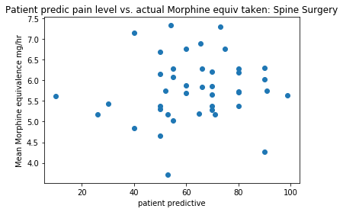
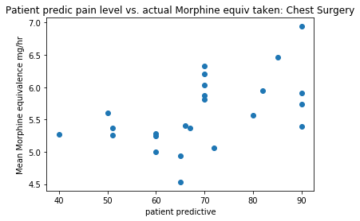
Predicted pain scores vs. Morphine equivalence
Predicted pain scores vs morphine equivalence
Between patient predictive pain level and amount of morphine equivalent administered for spine surgery | Between patient predictive pain level and amount of morphine equivalent administered for chest surgery
0.09201658 (very weak) | 0.52251323 (moderate)

Slide 14
Morphine equivalence vs. Patients' actual pain level

Slide 15
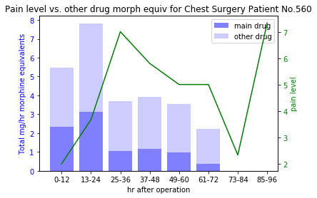
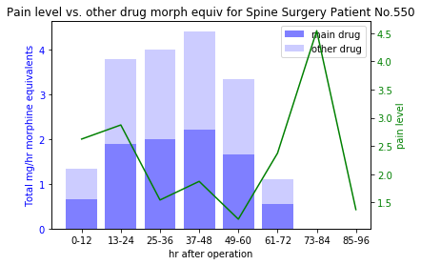
Trend 1
Actual pain scores vs morphine equivalence
There are evidences of patients that fit trend that higher pain level when less morphine equivalent administered and lower pain level when more morphine equivalent administered.

Slide 16
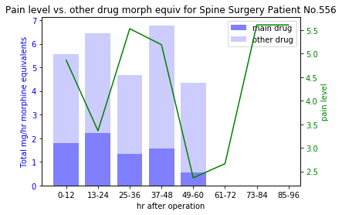
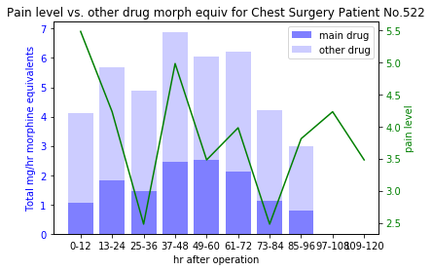
Trend 2
Actual pain scores vs morphine equivalence
There are also evidences of patients experience sudden drops in pain if a high level of morphine equivalence is administered for consecutive period.
Notes:
The way to segregated drugs(or say treatments) for each patient didn’t work here. Even we are able to do so, each specific treatment was only applied to one or two individuals, and it makes sense in the reality that each patient received his/her own specific treatment. If one wants to measure effectiveness of particular drugs and ROI, patients should be given consistent drug types.

Slide 17
Regression Analysis

Slide 18
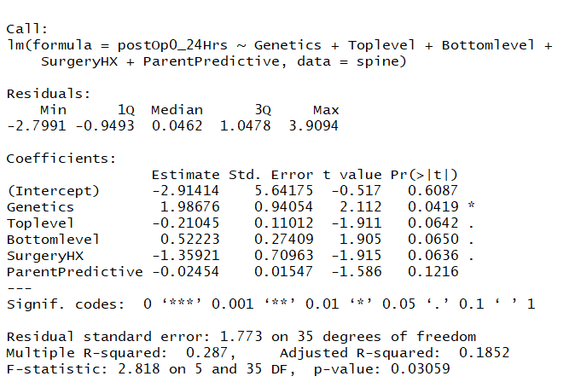
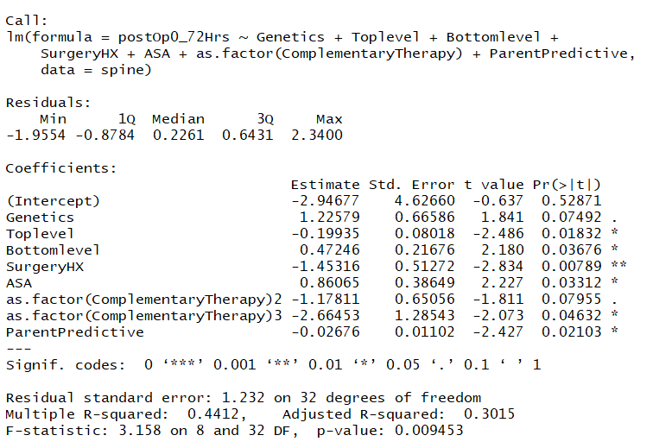
Significant Factors for 0-24 hrs vs 0-72 hrs Spine Surgery
Regression Analysis
Significant variables: Genetics, Top Level, Bottom Level, Significant Variables: Genetics, Top level, Bottom Level,
Surgery HX SurgeryHX, ASA, Complementary Therapy
SurgetyHX

Slide 19
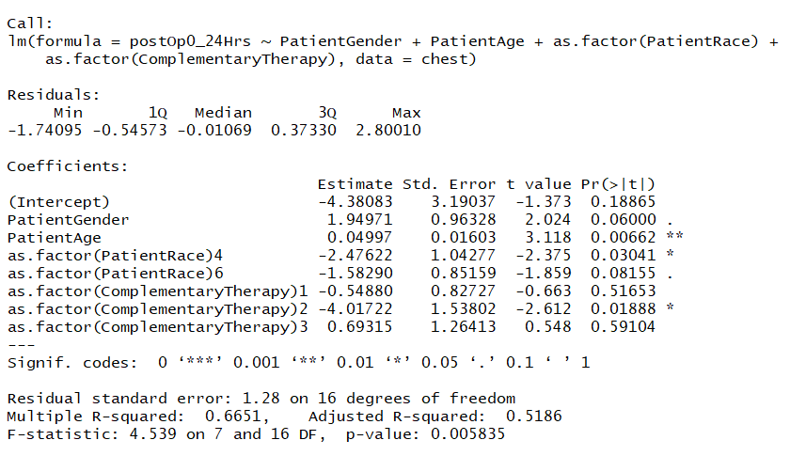
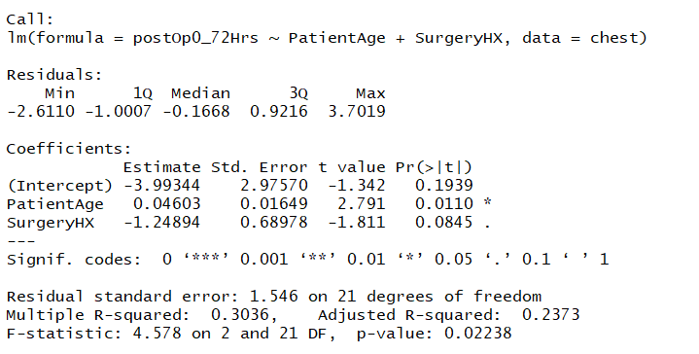
Significant Factors for 0-24 hrs vs 0-72 hrs Nuss Surgery
Regression Analysis
Significant variables:Patient Gender, Patient Age, Significant Variables: Patient Age, SurgeryHX
Patient Race, Complementary Therapy
SurgetyHX

Slide 20
Conclusion and ROI

Slide 21
Patient segmentation with age
Return on Investment
Age significant factor in determining pain trends.
More resources can be dedicated to older patients with similar problems that are at higher pain risk.
Age can be experimental factor for further analyses.

Slide 22
Pain mitigation before certain time periods
Return on Investment
For spine surgery, most patients experience the most pain in the 61-72 hour period and adjacent periods.
Preventive measures like extra care or sedation can be administered ahead of time to mitigate expected pain levels.
Similar steps apply to the first 24 hours for chest surgery patients.

Slide 23
Therapy services
Return on Investment
Therapy has an effect on reducing pain after 24 hours.
It is most helpful in reducing pain between 24-72 hours.
If complimentary or discounted therapy sessions were provided, the hospital could free up beds for more severe patients and save on manpower cost covering longer patient stays.

Slide 24
Thank you!

